Slide 1
WICCI COUNCIL MP TEAM
WOMEN´S INDIAN CHAMBER OF COMMERCE AND INDUSTRY
www.wicci.in

Slide 2
Council Vision &Mission
;
VISION:To empower women physically’mentally’emotionally and most importantly financially. We would like to contribute our services to empower women.
MISSION:To serve humanity and happiness to each and everyone. We would like to provide a platform to those who are having a caliber and skills to showcase their talent.

Slide 3
Welcoming
Council Members to
WICCI
President, Vice President
and 20+ Nominated Council Members

Slide 4
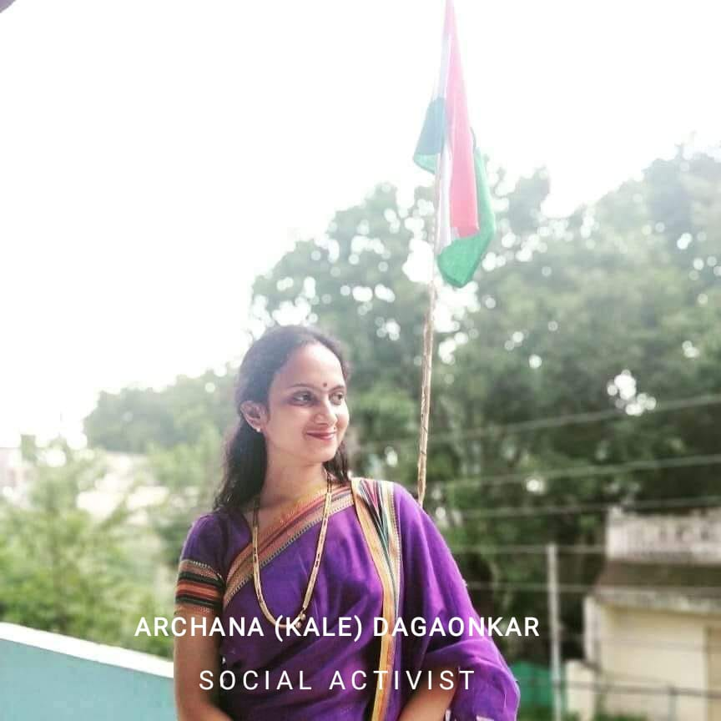
(MS. ARCHANA KALE DAGAONKAR) PRESIDENT, WICCI MP TEAM
BIO:-
EXPERTISE:-Social Activist
DESCRIPTION:-I am working as a Social Activist and Founder of Uddeshika group and works for upliftment of underprivileged children and women. I provide workshops regarding Textile Block Printing and Tie and Dye which helps Women to start their small set up in less investment and in less are. My first aim is to serve humanity and give happiness to each and every person who deserves along with this I would like to provide a platform to those folks who are having caliber and skills to showcase their talent. Inshort,I want to be a first order Human being
Insert High Resolution Picture

Slide 5
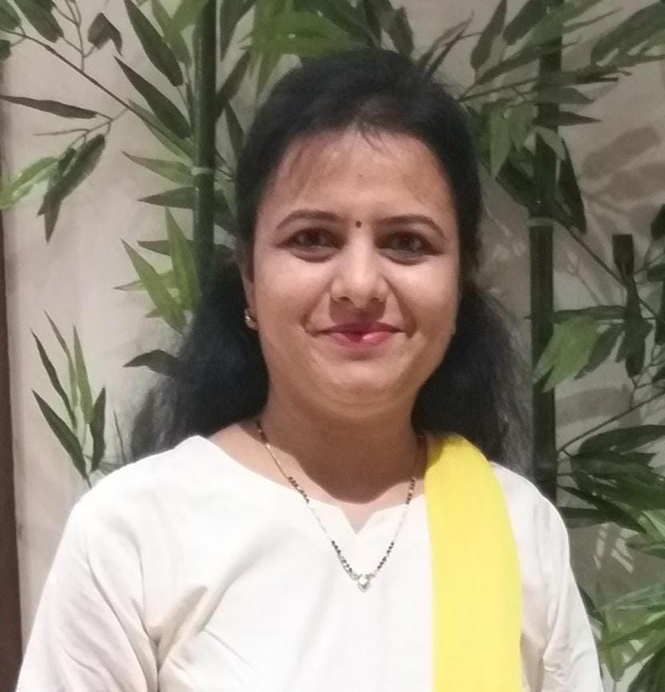
SNEHAL JOSHI VICE PRESIDENT, MP TEAM COUNCIL WICCI
BIO :-
Expertise: Social Activist,Business Woman
Describe yourself: I am from indore. Presently I am working as Managing Director at Lokmanya Vidya Niketan (a reputed CBSE School in Indore). Also, I am owning Shree - The Fashion Gallery (Exclusively for women) at Indore.
I am a soft, polite, logical and decision making person. I am a disciplined and justice oriented person, and can do anything to support the right.
I love to work for society and I wish to contribute for the development of the lower segment of society.
Even though I am working as a business woman, through my business also I am providing benefits to whomever I can as much as possible
Insert High Resolution Picture

Slide 6
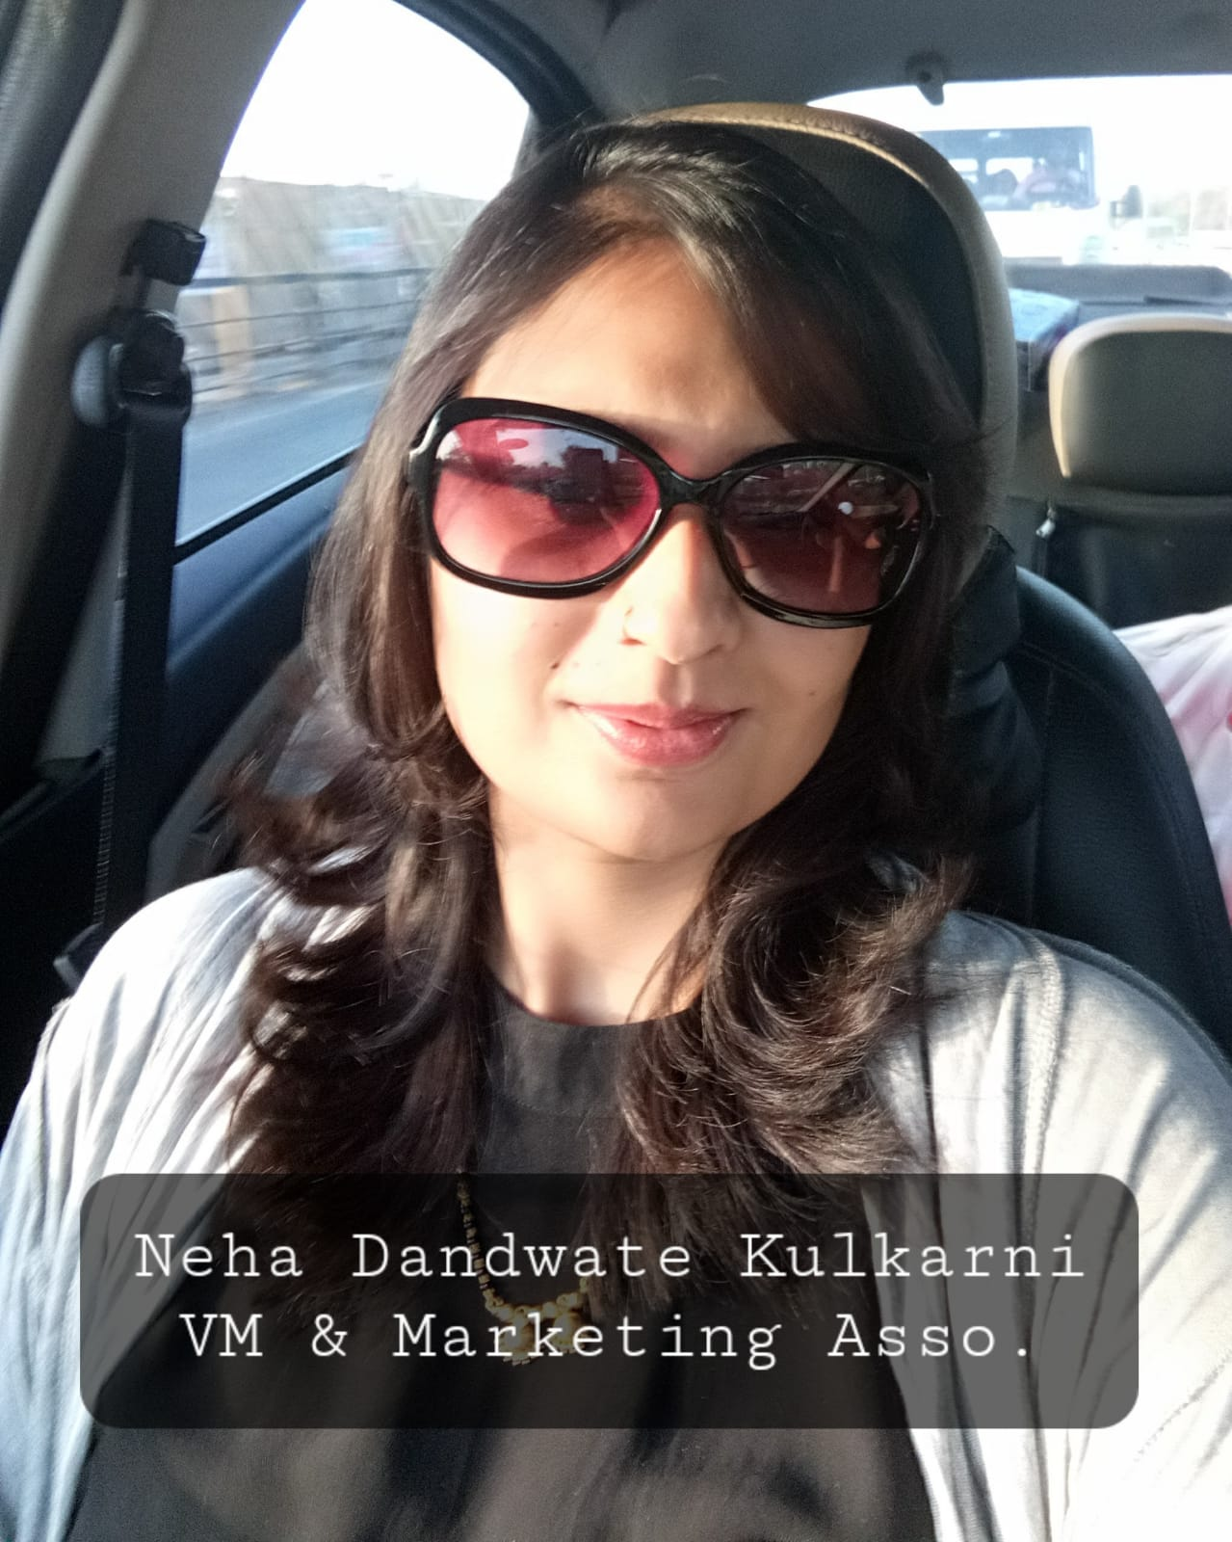
NEHA DANDWATE KULKARNI
COUNCIL MEMBER,
BIO:-
Expertise: Visual Merchandiser & Marketing Professional Describe yourself: I'm a Design Graduate from Indore and has experience of working in retail industry as a Visual Merchandiser and Marketing professional, across multiple territories like India, Europe and Middle East. I was responsible for Merchandising, Store Design & planogram, Events and Promotion along with vendor management, which helps Small & Medium Enterprises (SME) to grow their business.I always wanted to use my experience to make positive impact in Woman empowerment. Being in a Merchandising profession, I always felt that wearing right cloths with right attitude gives women the extra confidence to pursue the goals. I would love to share my this experience for enrichment and empowerment of women.
Insert High Resolution Picture

Slide 7
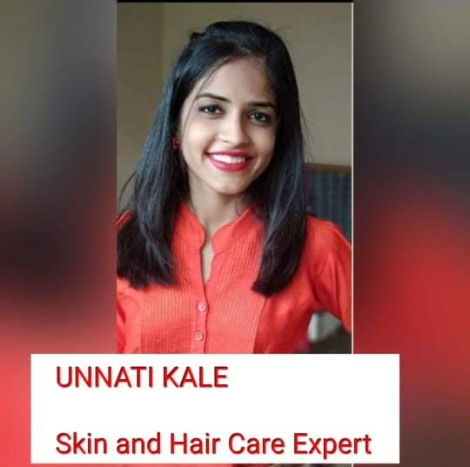
UNNATI KALE,COUNCIL MEMBER,
BIO :-
Expertise:- Skin and Hair care
Describe yourself:- I am from Indore. Presently...i complered my graduation and currently i'm pursuing company secreteries of India as well as i have my youtube channel for self care named as Organic self love...i make videoes related to Skin and Hair care...Basically i want to make every women confident and look good because in today's busy life it is very difficult for us to take care of ourself or pamper ourself...from july 2021 i'm associated with WICCI as council member and i'm looking forward to contribute my efforts for it as much as i can.. I love doing social activities. I'am pretty good at editing related work...
Insert High Resolution Picture

Slide 8
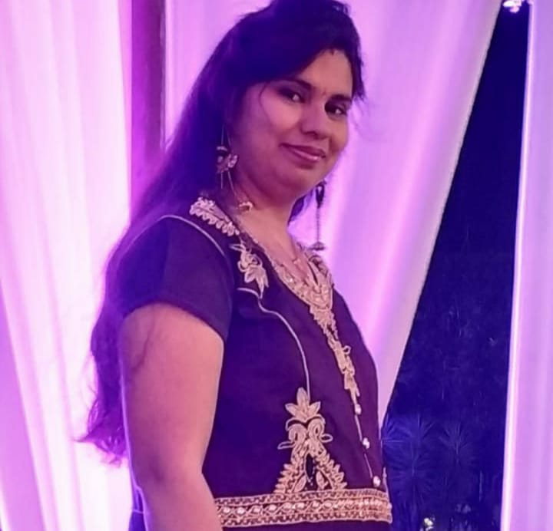
Council member
HIMANI KESWANI
Expertise:- Finance and Human Resource Management
Describe yourself : Born and brought up in Indore. A Graduate in Commerce and holder of Diploma in Banking Operations and currently pursing MBA in Human Resource Management. Have been passionately working in the Finance, Accounting and HR field and was previously associated with the prestigious organization named ICICI Bank.
BIO :-
Insert High Resolution Picture

Slide 9
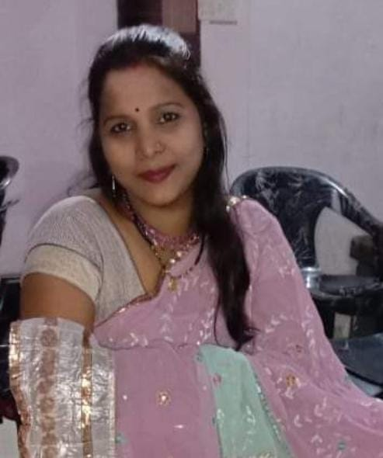
ANITA MEHRA
COUNCIL MEMBER
BIO:-
I am youtuber, my channel name is "Anitas art room"I am also available on"Instagram and Facebook Founder and director of: Janvi craft and creation I am blogger in momspresso
Insert High Resolution Picture

Slide 10
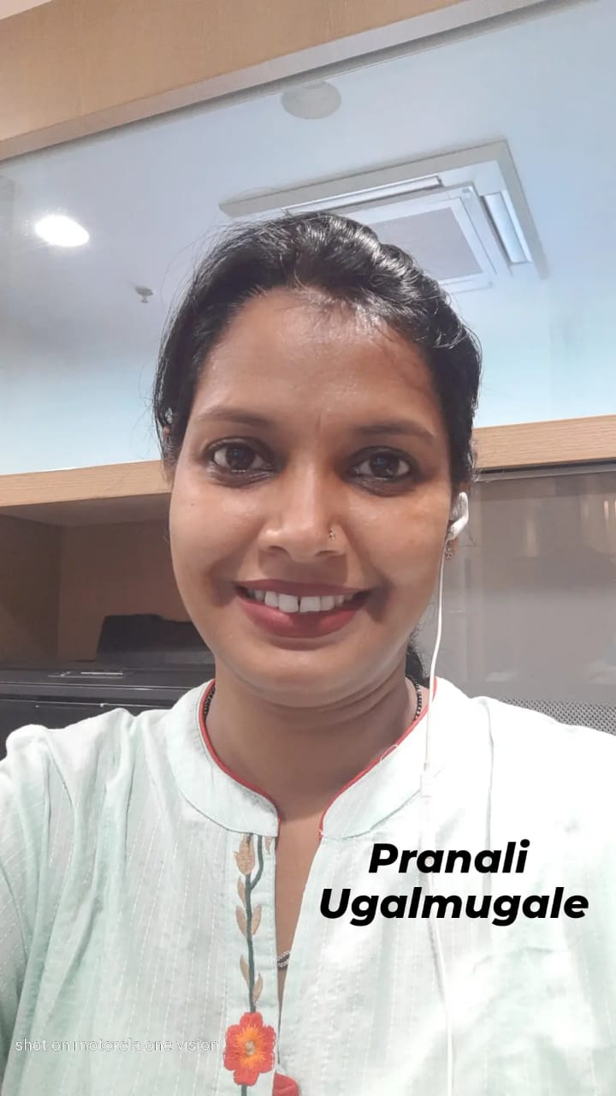
PRANALI UGALMUGLE
COUNCIL MEMBER
BIO :-
Describe yourself “I am passionate about my work as well as my duties towards my family. Because I love what I do, I have a steady source of motivation that drives me to do my best. In my every job, my passion lead me to challenge myself daily and learn new skills that helped me to do better work.
Insert High Resolution Picture

Slide 11
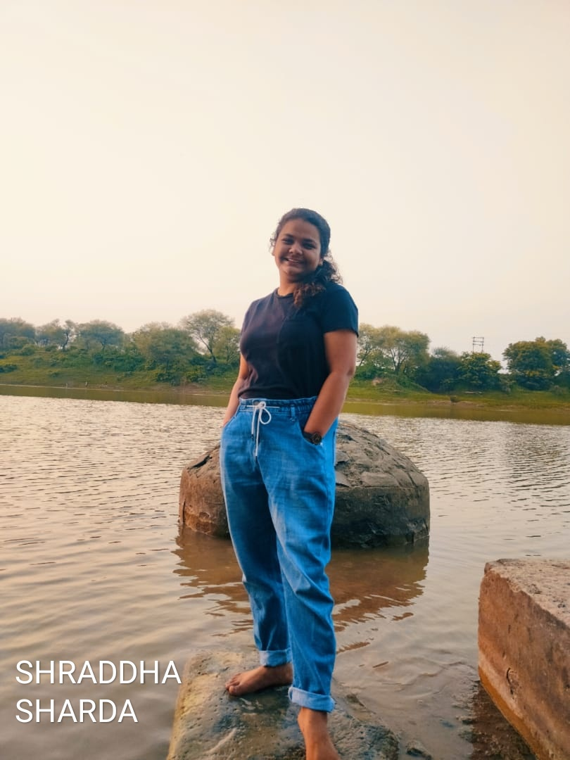
SHRADDHA SHARDA
COUNCIL MEMBER
BIO:-
Describe yourself: I am an Engineer and currently working to build my own buissness.I even have an instagram page by name of Curly stories where I do still fashion photography and manage the page.I love cooking.
Insert High Resolution Picture

Slide 12
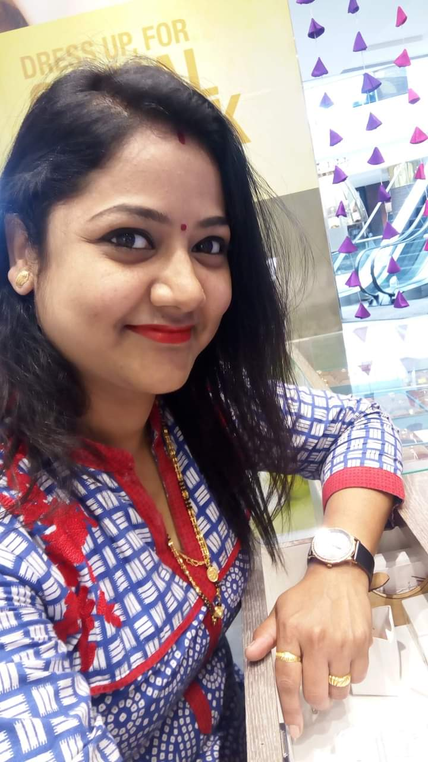
KIRTI SAWAI
COUNCIL MEMBER
BIO
Expertise:-Conducting seminar on women's hygiene and awareness.
Describe yourself:-I am from pune and I am working as Director in KS Enterprise (Onlynaari)for 6 years. I am conducting seminars at schools, colleges and corporates to educate women's for hygiene during and post menstruation with our only naari products.
Insert High Resolution Picture

Slide 13
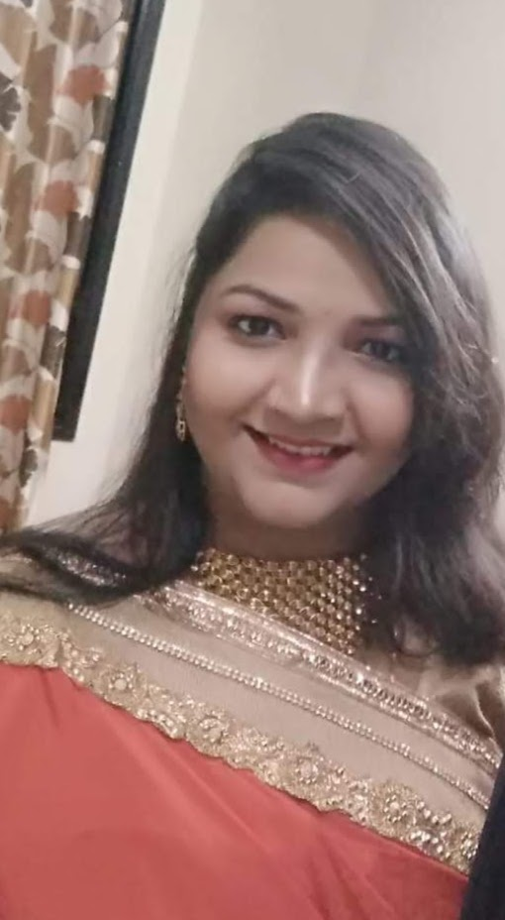
VINITA MISHRA
COUNCIL MEMBER
BIO:-
Describe yourself: I am from indore. Presently I am home maker and handle promotion activity of my husband's business. Basically i have export executive. After that i am doing something. Yes!!! Remaining all this i hold creative minded, i can manage many event like Birthday parties,mahila sangeet, anniversary parties etc. Sometimes i become choriographer and write poem on situations.
Insert High Resolution Picture

Slide 14
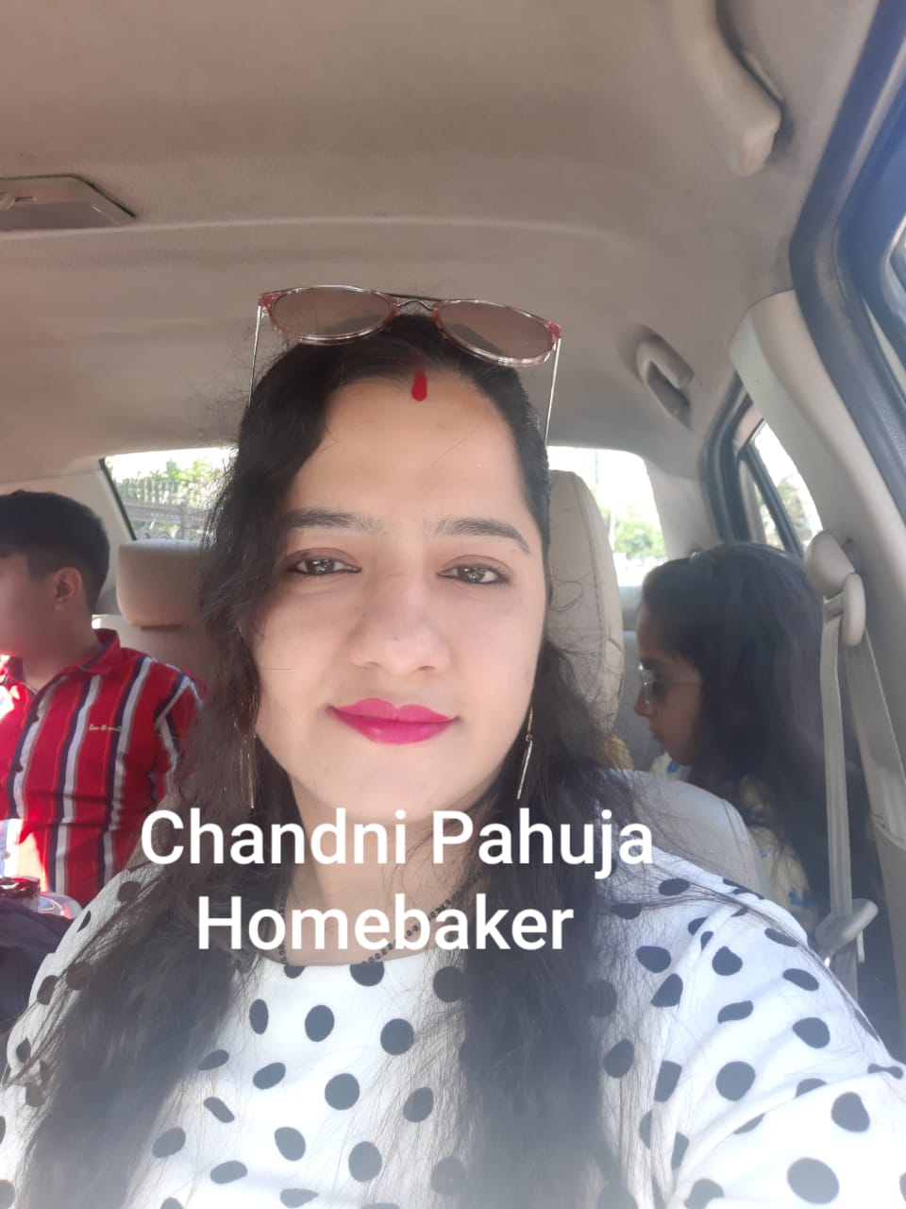
CHANDNI PAHUJA
COUNCIL MEMBER
BIO:-
Describe yourself: I am from indore ..I am working as a homebaker..I just love making cakes with scratch and unique flavour...I can customize as per customer's choice
Insert High Resolution Picture

Slide 15
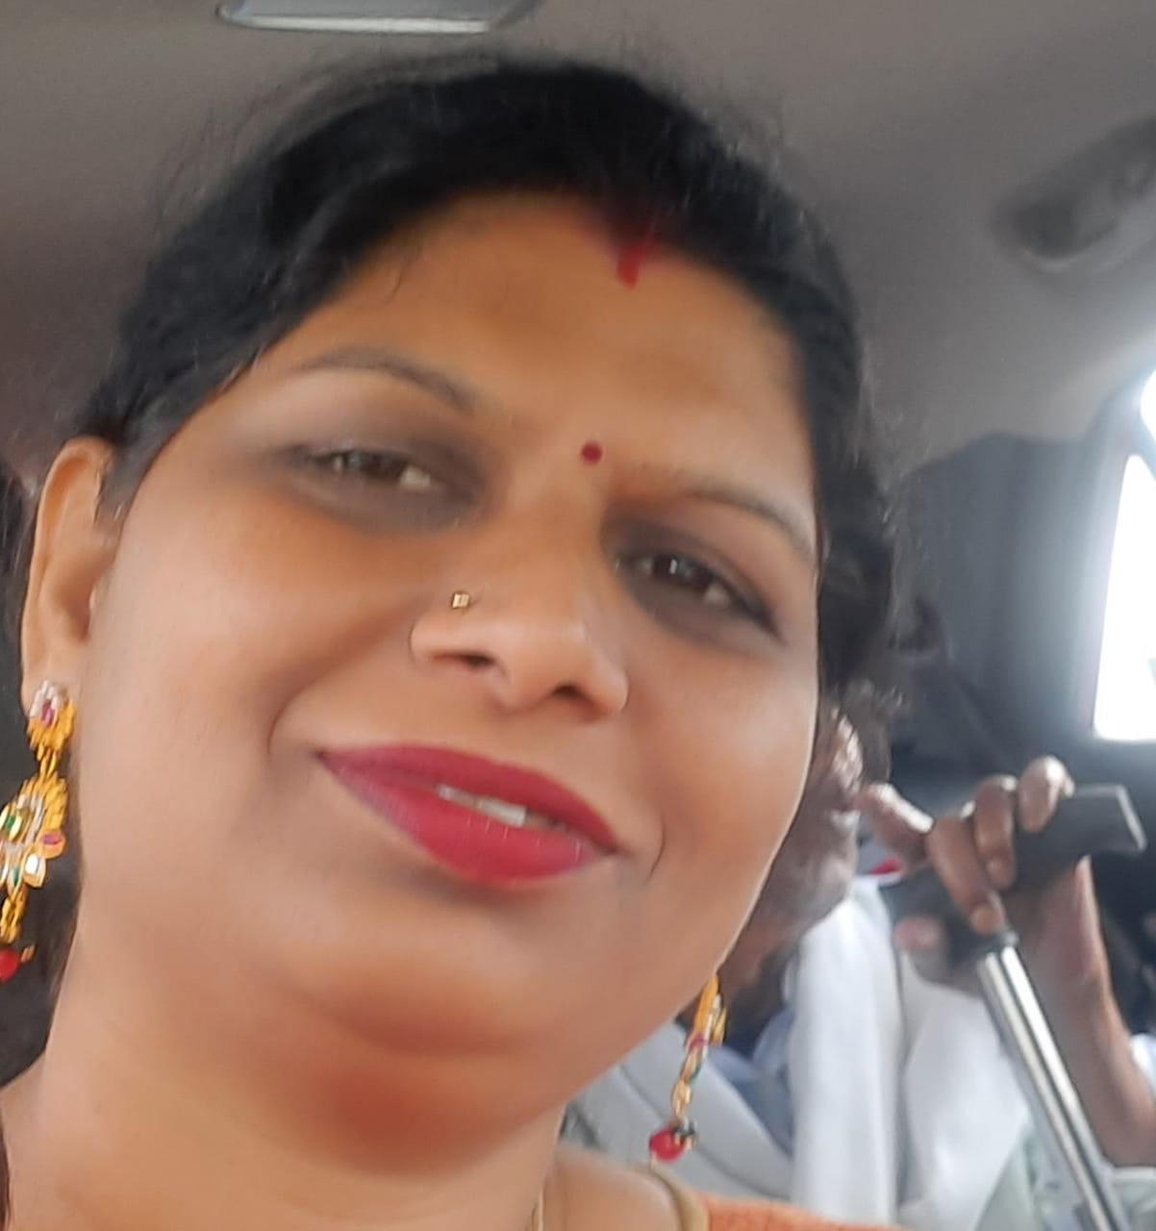
PUSHPA CHOURASE BANSIWAL
COUNCIL MEMBER
BIO :-
EXPERTISE:worked as software and technical skills
Describe yourself: Decision making person,self motivated,determinant,creative,focused,good listener.
Insert High Resolution Picture

Slide 16
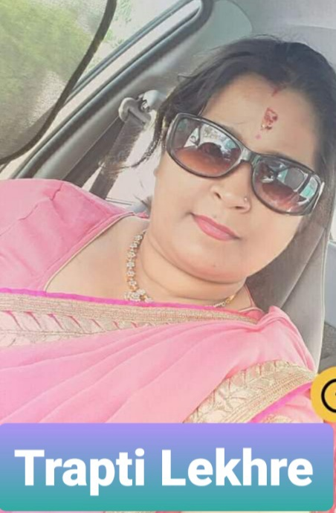
TRAPTI LEKHRE
COUNCIL MEMBER
BIO:-
Expertise:Have been worked in Finance field for 8years,and now I am a co-founder and a business Coordinator at Envirotap Technologies and Services, and having one more firm of Chocolate making,I am a plant lover,a good cook,a music lover,and an artist.
Insert High Resolution Picture

Slide 17
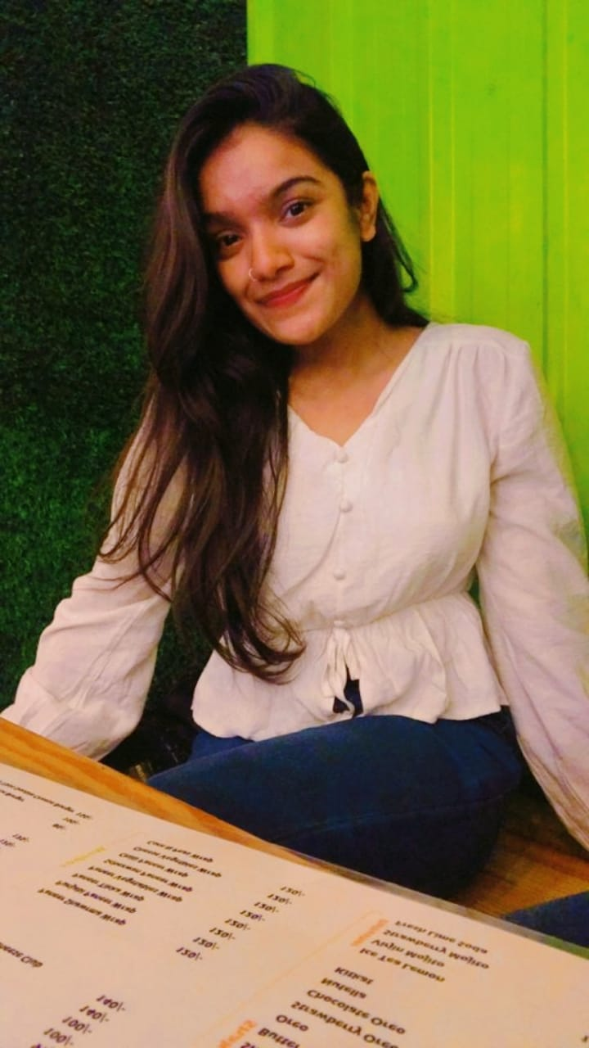
NAVNI NISHIKANT GANDHE
COUNCIL MEMBER
BIO:-
Expertise:Yoga professional
Describe yourself: Getting to know me was always been so difficult. At the age of 7, I've been doing yoga,stretching myself out,and doing different things. Once I'd been rejected in interschool competition then too I'd never low down my expectations! And now I'm here an international yoga player. I'd been gone through lot. Only at this age I understood that I don't care about people anymore( about there thinking, when they are judging me, body shaming me) but atlast this is me. My family and my friends are my strength. I'll do anything for them in a good way! Atlast I would like to say that I would always love to do something for everyone!
Insert High Resolution Picture

Slide 18
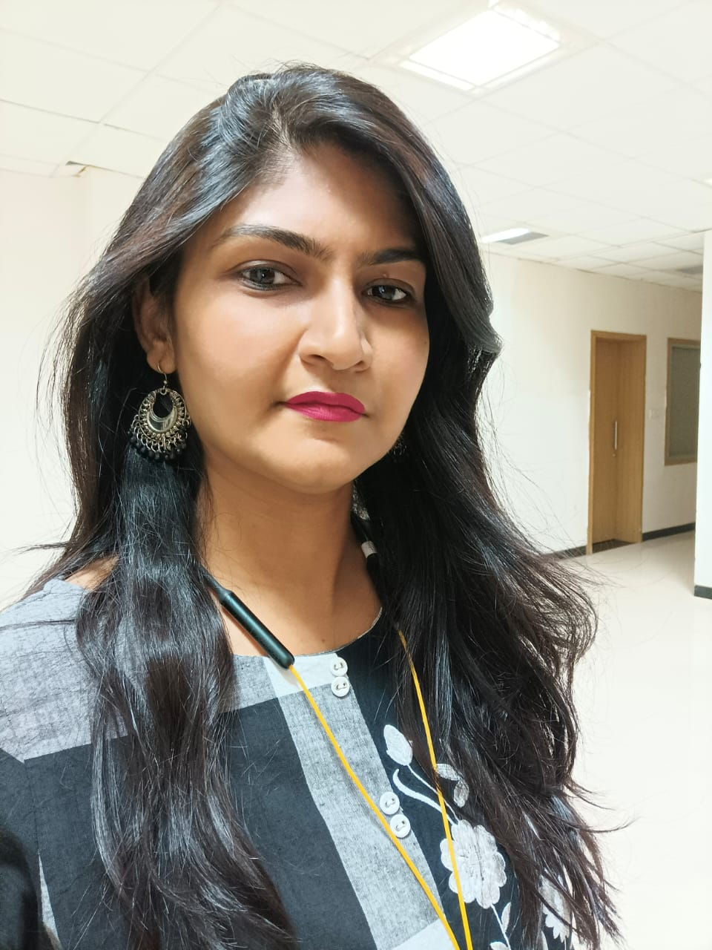
JAGRUTI PATIL
COUNCIL MEMBER
BIO:-
Expertise:fabric
Describe yourself:I love to learn ,create ,best analyser and leader
Insert High Resolution Picture

Slide 19
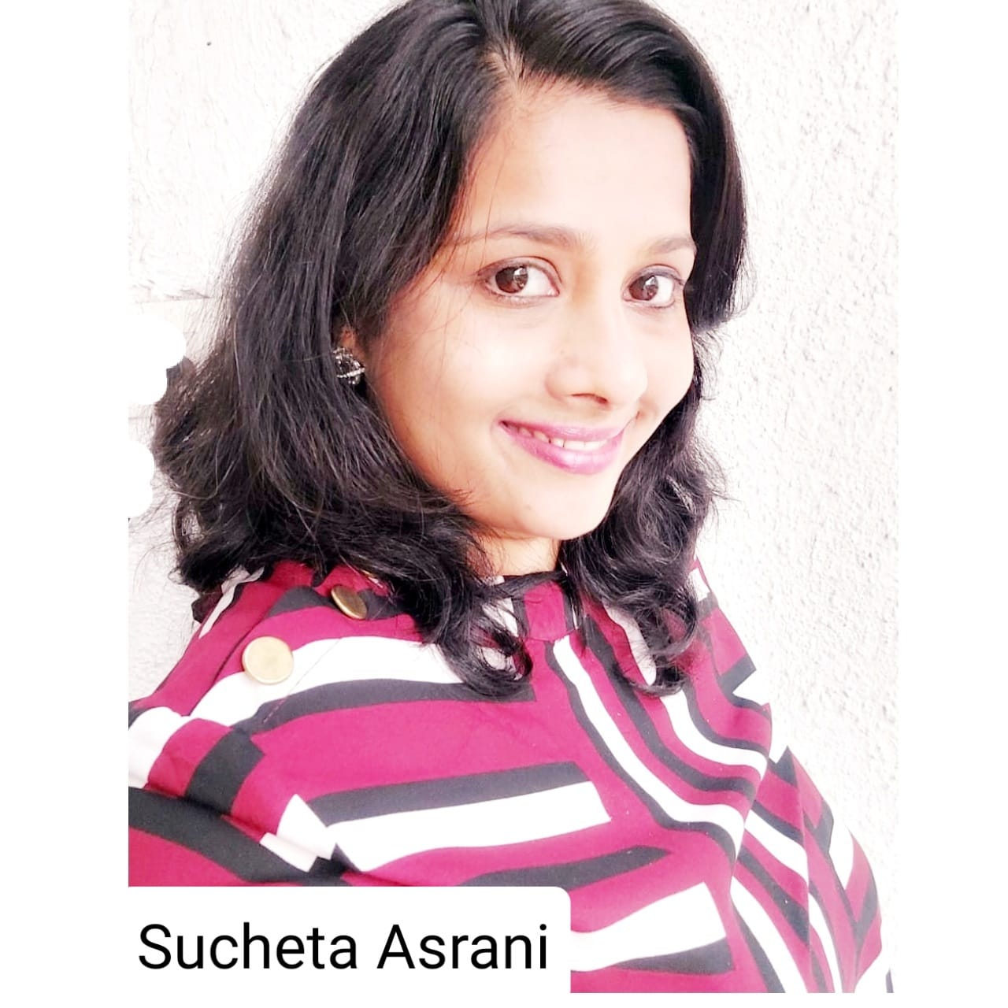
SUCHETA ASRANI
COUNCIL MEMBER
BIO:-
Expertise: Digital Marketing, Content Development, Writing ( education and entertainment)
Describe yourself: I M a headstrong passionate person with determination towarda whatever I do.
Insert High Resolution Picture

Slide 20
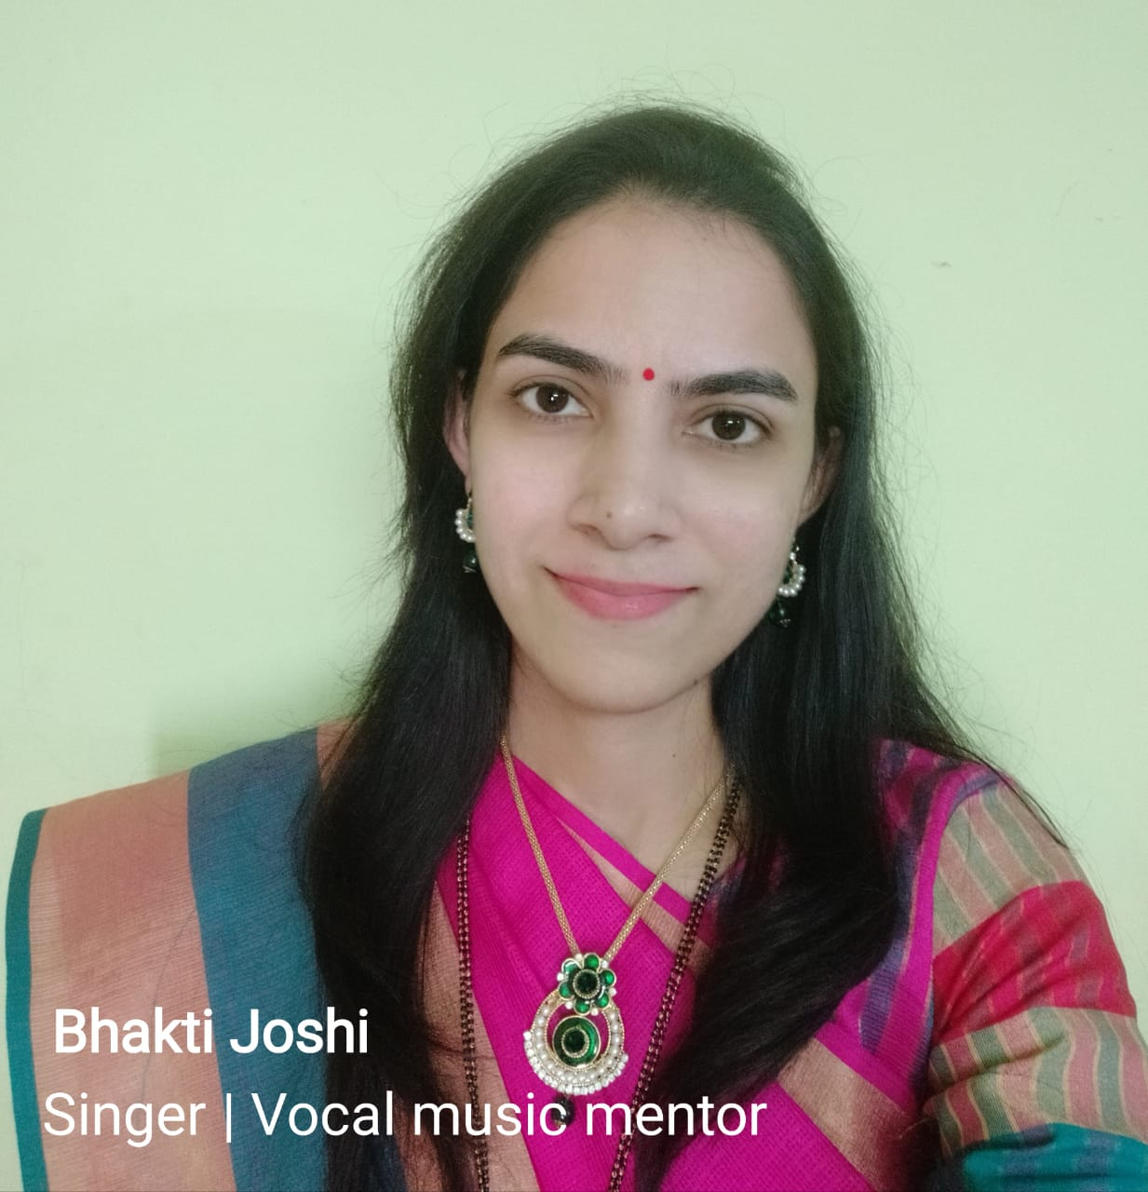
BHAKTI JOSHI,council member
BIO :-
Expertise: in teaching Vocal Music, singer/artist
Describe yourself: I am a singer, vocal music mentor and an artist. I have an overall 2 years of work experience. One year in IT industry where I worked as a web designer and another in academic teaching. My Subject was computer. Currently, I am self employed and have been teaching Vocal music(Indian classical and Light music) for last 3 years. I have participated earlier in the musical events and painting exhibition events happening in Indore.I believe that music and art have the ability to bring about positive impact in the lives of people. It helps in the overall development of mind and health and it cultivates good culture and good habits in people.
Insert High Resolution Picture

Slide 21
TYPE NAME & WICCI DESIGNATION
COUNCIL MEMBER, (…………. )COUNCIL WICCI
BIO :-
Type Text
Insert High Resolution Picture

Slide 22
TYPE NAME & WICCI DESIGNATION
COUNCIL MEMBER, (…………. )COUNCIL WICCI
BIO :-
Type Text
Insert High Resolution Picture

Slide 23
TYPE NAME & WICCI DESIGNATION
COUNCIL MEMBER, (…………. )COUNCIL WICCI
BIO :-
Type Text
Insert High Resolution Picture

Slide 24
TYPE NAME & WICCI DESIGNATION
COUNCIL MEMBER, (…………. )COUNCIL WICCI
BIO :-
Type Text
Insert High Resolution Picture

Slide 25
TYPE NAME & WICCI DESIGNATION
COUNCIL MEMBER, (…………. )COUNCIL WICCI
BIO :-
Type Text
Insert High Resolution Picture

Slide 26
SUPPORTED BY
WICCI is supported by the massive global networks of ALL Ladies League (ALL), Women Economic Forum (WEF), and SHEconomy.
ALL is a movement of ‘Sisters Beyond Borders.’
WEF is a platform for ‘Business Beyond Borders.’ SHEconomy is e-commerce for women worldwide in Goods & Services for ‘Commerce Beyond Borders’

Slide 27
COUNTRIES REPRESENTED
Albania, Angola, Armenia, Argentina, Australia, Azerbaijan, Bangladesh, Brazil, Burundi, Cameroon, Canada, Chad, China, Costa Rica, Croatia, Cyprus, Czech Republic, Colombia, Ecuador, Egypt, Ghana, Germany, Greece, Guatemala, Hong Kong, Hungary, India, Italy, Israel, Ireland, Japan, Kazakhstan, Kenya, Kyrgyzstan, Lesotho, Luxembourg, Malawi, Malaysia, Mexico, Moldova, Monaco, Montenegro, Morocco, Mozambique, Malta, Netherlands, Nigeria, Nepal, New Zealand, North Macedonia, Norway, Paraguay, Portugal, Peru, Puerto Rico, Philippines, Qatar, Romania, Russia, Rwanda, Serbia, Singapore, Slovenia, Spain, South Africa, South Korea, Suriname, Sweden, Switzerland, Syria, Tunisia, Turkey, Uganda, Ukraine, UK, Uruguay, Venezuela, Vietnam, Virgin Islands (US), UAE, USA, Uzbekistan, Zimbabwe.

Slide 28
WOMEN'S INDIAN CHAMBER OF COMMERCE ANDINDUSTRY

